Slide 1
Real-Time Deep Learning Classifier
for Multiclass Motor Imagery BCIs
BME 707 | Final Progress Presentation
Giacomo Albergo
Department of Biomedical Engineering | University of Miami | Spring 2026
BCI · Motor Imagery · EEGNet · ShallowConvNet · CSP+LDA · Real-Time Decoding

Slide 2
Clinical Motivation
Why Motor Imagery BCI matters
Brain
(Motor Imagery)
The Problem
Spinal cord injury (SCI) disrupts motor commands from brain → limbs
~300,000 people living with SCI in the US; ~17,800 new cases/year
C5–C6 motor-complete: hands and arms paralyzed
EEG
Acquisition
The Solution: BCI-FES
Real-Time
Classifier
Decode motor intent from scalp EEG non-invasively
Translate imagined movement → trigger Functional Electrical Stimulation
Restore voluntary hand/arm function without surgery
FES Device
(Muscle Stim)
⚡ ERD in mu/beta bands → action vs. rest → stimulate!
Giacomo Albergo | University of Miami | BME 707 Final Presentation | 2/14

Slide 3
Dataset & Preprocessing Pipeline
BIDS-formatted EEG Motor Imagery dataset
11
≤6
20
256 Hz
Subjects
(SCI + Controls)
Sessions
per Subject
EEG Channels
10-20 System
Sampling
Rate
Standardized Preprocessing
01
02
03
04
05
Bandpass Filter
Epoching
Artifact Rejection
Normalisation
Standardise Length
4th-order Butterworth 8–30 Hz (mu + beta)
4-second windows (0.5–4.5 s post-cue)
Drop epochs > 100 µV
Per-channel z-score
Trim to 1024 samples (RT_EPOCH_S) — AMD DirectML fix
Giacomo Albergo | University of Miami | BME 707 Final Presentation | 3/14

Slide 4
Phase 1 — Four Classification Methods
Baseline comparison across architectures
EEGNet
ShallowConvNet
CSP + LDA
Band-Power
SVM
LOSO
LORO
LORO
LORO
Mean Balanced Acc.
Mean Balanced Acc.
Mean Balanced Acc.
Mean Balanced Acc.
72.1%
66.5%
67.2%
~58%
Params: ~2,962
Params: ~38,042
Params: ~120
Params: ~100
CV: Leave-One-Subject-Out
CV: Leave-One-Run-Out
CV: Leave-One-Run-Out
CV: Leave-One-Run-Out
Compact CNN
Best cross-subject
generalization
Spectral-spatial
filtering
Best per-session
Classical gold
standard
< 100 ms training
Replicates
publication
feature extraction
Giacomo Albergo | University of Miami | BME 707 Final Presentation | 4/14

Slide 5
Phase 1 — Performance Summary
Cross-subject balanced accuracy by method
50% chance
Key insight: Subject identity drives performance more than algorithm choice. Sub-08 and Sub-11 reach 88–89% across all methods; Sub-10 struggles near 54% across all methods.
Giacomo Albergo | University of Miami | BME 707 Final Presentation | 5/14

Slide 6
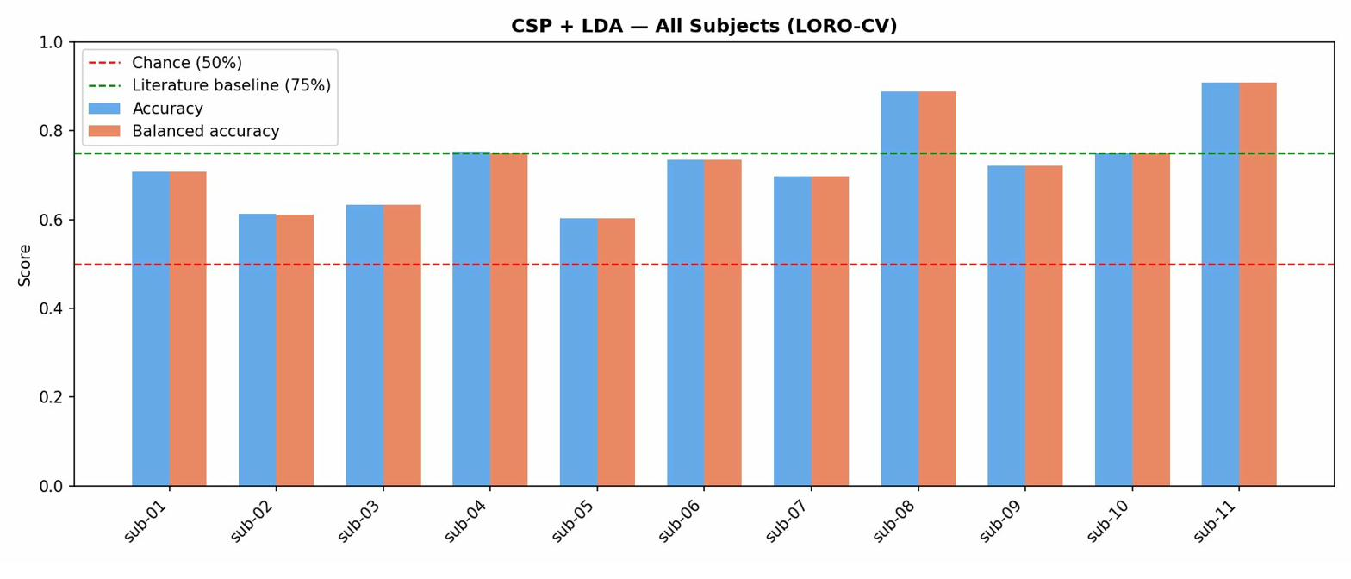
CSP Spatial Filters — All Subjects
ERD topography captured by Common Spatial Patterns
Each row = one subject. Colour = spatial filter weight. Contralateral sensorimotor focus (C3/C4) indicates strong ERD.
Giacomo Albergo | University of Miami | BME 707 Final Presentation | 6/14

Slide 7
Pipeline v2 — Diagnosing v1 Failures
Two critical flaws that invalidated v1 results
Problem 1: Overfitting to Session Noise
v1 (broken)
v2 (fixed)
Train on 2 runs (~50 epochs) within the same recording session → model memorizes noise artifacts, not MI patterns → inflated ~85% offline accuracy
→
Train on ALL sessions except the last → honest ~67–76% cross-session accuracy that actually correlates with real-time performance
Problem 2: Training / Test Format Mismatch
v1 (broken)
v2 (fixed)
Models trained on clean event-aligned MNE epochs → threshold calibrated on perfect windows → at real-time inference the model sees sliding, misaligned, transitional windows it has never encountered
→
Neural networks trained directly on sliding-window buffered data → threshold calibrated on a mini RT simulation → inference distribution matches training distribution
Giacomo Albergo | University of Miami | BME 707 Final Presentation | 7/14

Slide 8
Pipeline v2 Architecture
Leave-One-Session-Out · Sliding-Window Training · Streaming Threshold
① Training Data
② Threshold Calibration
③ Test (Held-Out)
Pool ALL sessions except last
Same training sessions, run 3
Last session only (different day)
Use runs 1+2 per session
Run mini RT simulation on
calibration continuous data
Run 3 continuous recording
→
→
Extract sliding windows (stride=32)
Grid search threshold 0.10→0.90
(step 0.02)
Full RT simulation with
calibrated threshold
Train: EEGNet, ShallowConvNet,
CSP+LDA, Band-Power SVM
Select threshold maximising
streaming balanced accuracy
Zero data leakage from
training or calibration
Same format as real-time inference
Subject-specific threshold stored
Final balanced accuracy reported
Best Model Selection: all 4 models trained → compare on calibration data → pick highest balanced accuracy → apply to test
Giacomo Albergo | University of Miami | BME 707 Final Presentation | 8/14

Slide 9
Phase 2 Results — All 11 Subjects
Offline model scores + real-time balanced accuracy on held-out test session
Subject | Best Model | Thresh. | EEGNet | Shallow | CSP+LDA | SVM | RT Acc.
Sub-01 | ShallowConvNet | 0.40 | 81.3% | 82.5% | 77.5% | 61.3% | 68.9%
Sub-02 | EEGNet | 0.48 | 75.0% | 72.5% | 57.5% | 62.5% | 75.3%
Sub-03 | ShallowConvNet | 0.26 | 78.3% | 82.1% | 67.9% | 71.9% | 76.1%
Sub-04 | CSP+LDA | 0.44 | 95.0% | 75.0% | 100% | 85.0% | 66.8%
Sub-05 | CSP+LDA | 0.42 | 65.0% | 63.8% | 70.0% | 67.5% | 64.9%
Sub-06 | EEGNet | 0.26 | 92.0% | 90.8% | 89.4% | 64.4% | 76.3%
Sub-07 | EEGNet | 0.28 | 73.8% | 68.8% | 71.3% | 60.0% | 74.8%
Sub-08 | ShallowConvNet | 0.22 | 95.0% | 100% | 80.0% | 80.0% | 86.0%
Sub-09 | ShallowConvNet | 0.24 | 87.5% | 90.0% | 76.3% | 68.8% | 76.5%
Sub-10 | EEGNet | 0.38 | 83.8% | 83.8% | 77.5% | 43.8% | 78.8%
Sub-11 | CSP+LDA | 0.20 | 92.5% | 93.8% | 96.3% | 85.0% | 71.2%
★ = best offline model selected | RT Acc. = real-time balanced accuracy on held-out session
Giacomo Albergo | University of Miami | BME 707 Final Presentation | 9/14

Slide 10
Key Results at a Glance
Multi-model pipeline v2 — cross-session real-time performance
75.6%
86.0%
8/11
>70%
Mean RT
Balanced Acc.
Best Subject
(Sub-08)
Subjects ≥70%
RT Accuracy
Target Threshold
for BCI-FES
Findings
No single model wins for all subjects — subject-specific selection is essential
Calibrated thresholds range from 0.20 to 0.48 — confirms one-size-fits-all fails
Sub-04: perfect 100% CSP+LDA offline; demonstrates classical methods remain competitive
Sub-08: 100% ShallowConvNet offline → 86% RT — small offline→RT gap confirms v2 fix
Giacomo Albergo | University of Miami | BME 707 Final Presentation | 10/14

Slide 11
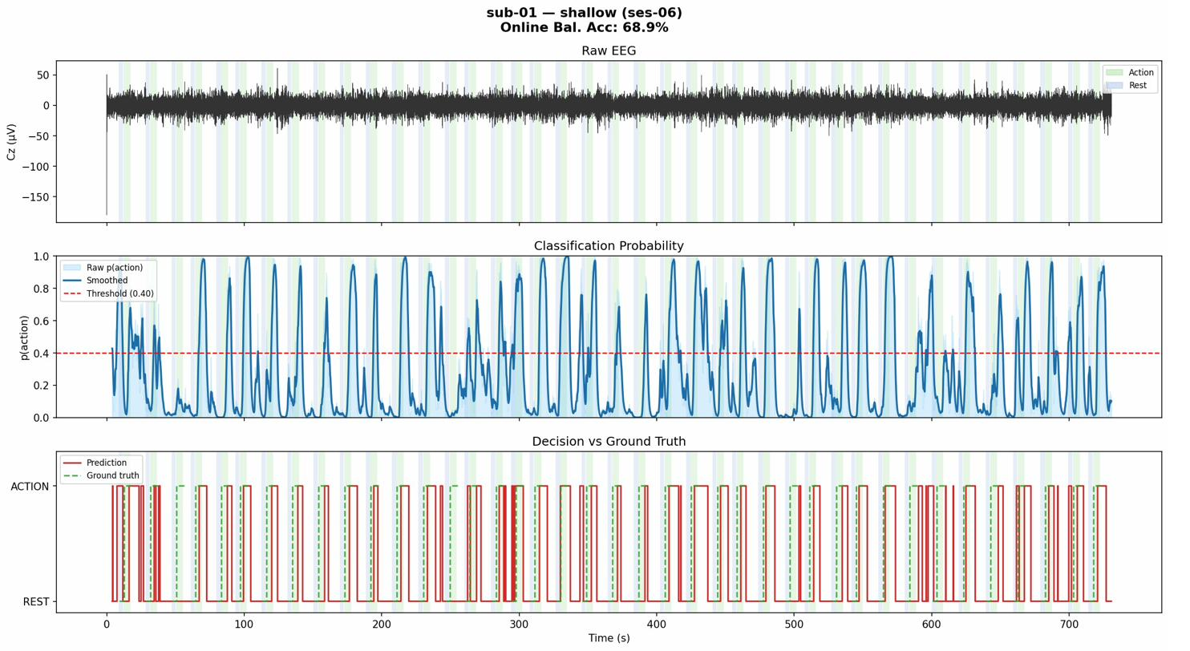
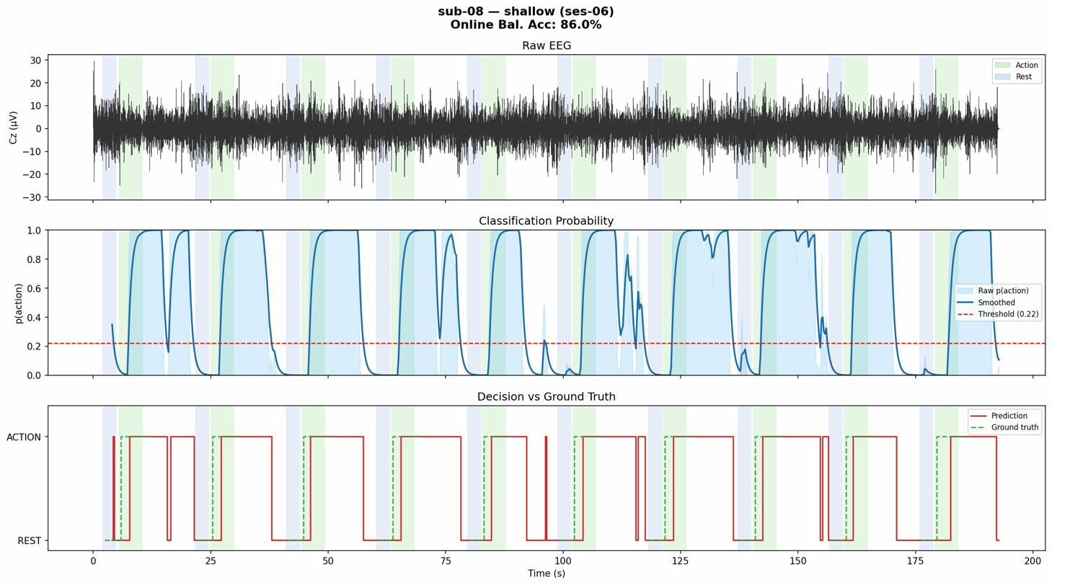
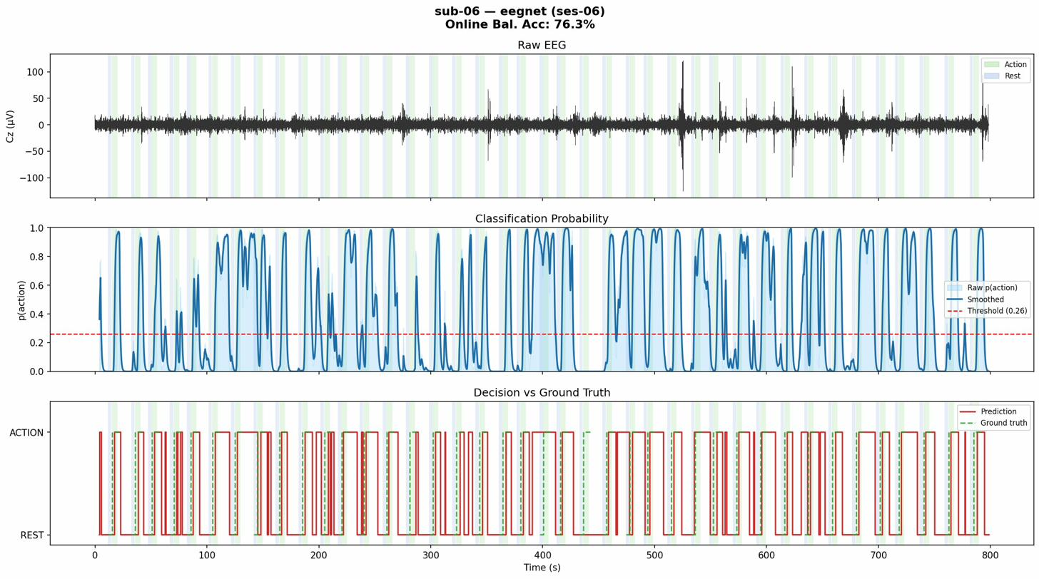
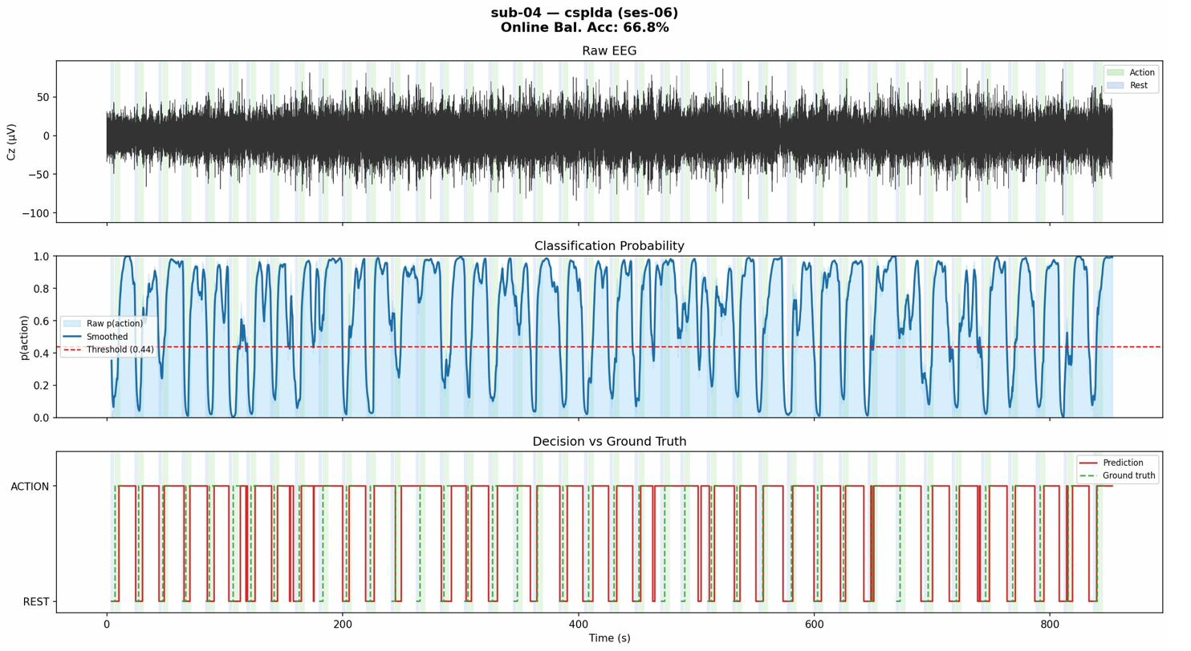
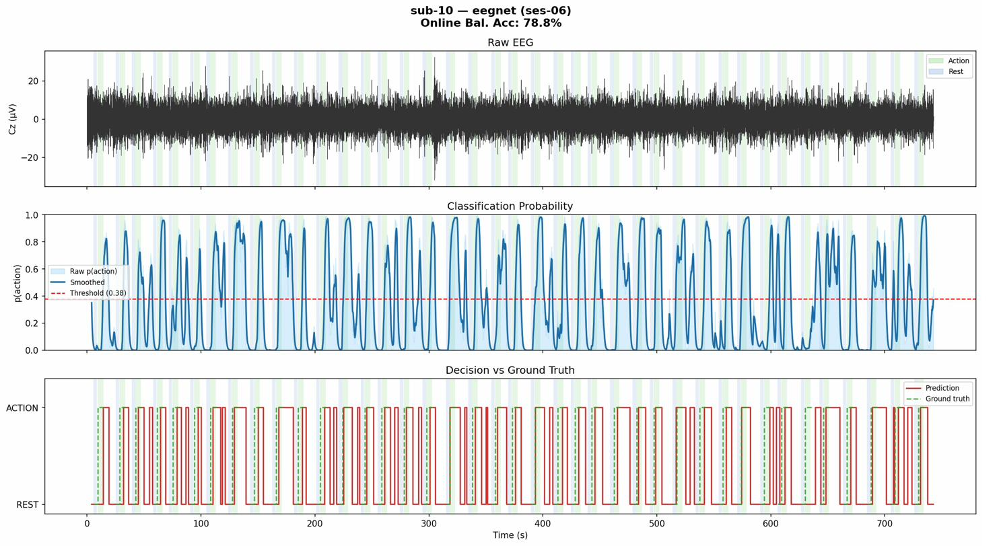
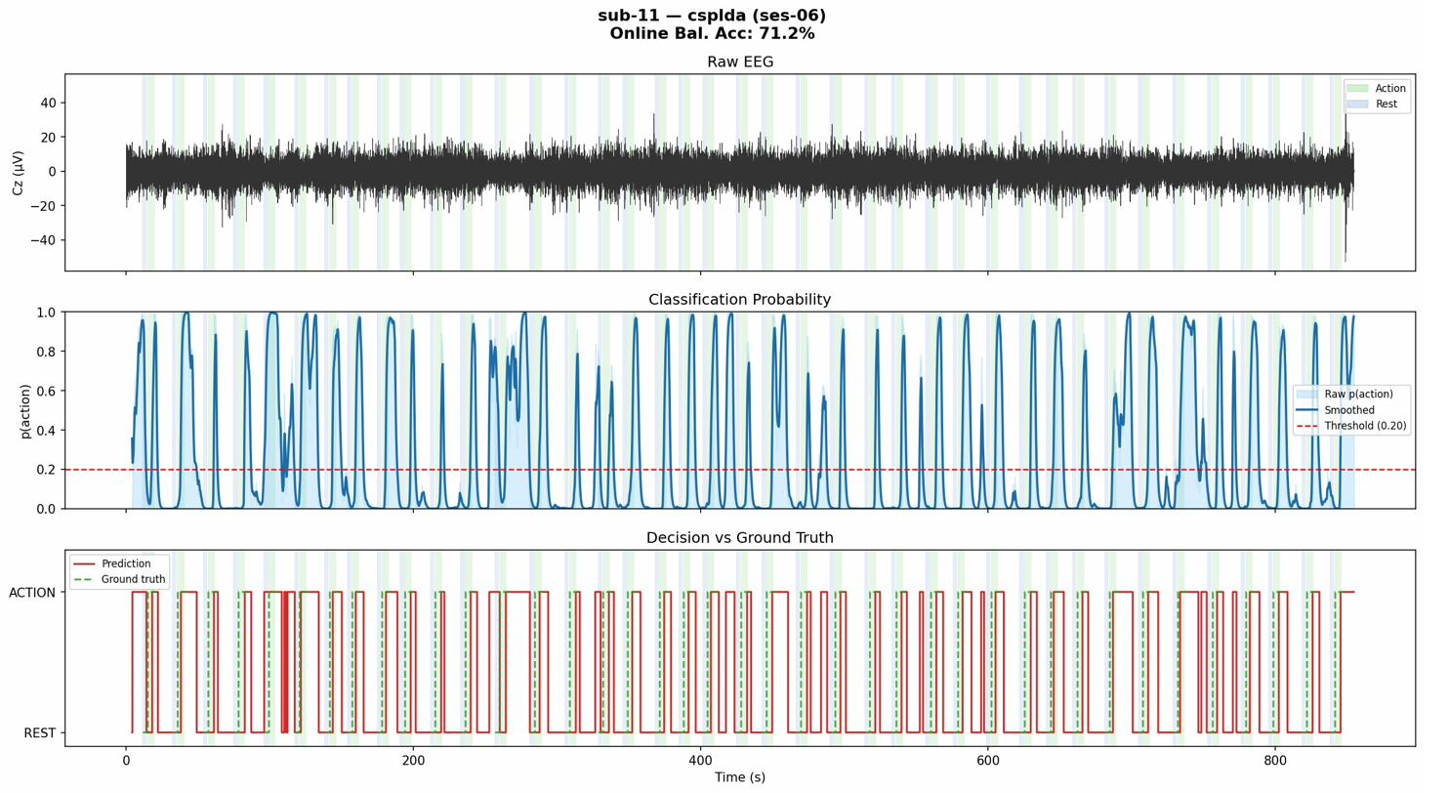
Real-Time Simulation — Selected Subjects
Top panel: classifier probability vs. threshold | Bottom: predicted class
Sub-01 | ShallowConvNet | 68.9%
Sub-08 | ShallowConvNet | 86.0% ⭐
Sub-06 | EEGNet | 76.3%
Sub-04 | CSP+LDA | 66.8%
Sub-10 | EEGNet | 78.8%
Sub-11 | CSP+LDA | 71.2%
Giacomo Albergo | University of Miami | BME 707 Final Presentation | 11/14

Slide 12
Conclusions
01
Honest cross-session evaluation is mandatory
Within-session accuracy (~85%) is inflated and meaningless for real-world deployment. Cross-session LOSO gives honest ~67–76% that tracks real-time performance.
02
Format consistency closes the real-time gap
Training on sliding-window buffered data (matching inference format) was the single biggest fix for real-time performance collapse in v1.
03
Subject-specific model selection outperforms any fixed architecture
ShallowConvNet, EEGNet, and CSP+LDA each served as best model for different subjects — adaptive multi-model pipelines are necessary.
04
75.6% mean RT balanced accuracy across 11 subjects
8/11 subjects exceed the 70% clinical feasibility threshold. BCI-FES integration is viable for the majority of users with this pipeline.
Giacomo Albergo | University of Miami | BME 707 Final Presentation | 12/14

Slide 13
BME 708 — Next Semester Plan
From feasibility to a deployable BCI-FES prototype
Jan 20
Feb 17
Feb 24
Mar 24
Apr 21
Apr 27
5-min Project Update
Presentation
Detailed Project Plan
Due
Mid-Term Presentation
(5+5 min)
Draft Report Due
Final Presentation
5:00–7:30 PM
Final Report Due
(approved by mentor)
🧠 Online Adaptive Calibration
⚡ FES Integration Prototype
📊 Formal Validation & Report
Implement session-to-session transfer learning (Euclidean alignment or domain adaptation)
Reduce calibration time from 30 min → < 5 min for clinical use
Online threshold drift correction using exponential moving average
Connect classifier output to a hardware trigger (Arduino / DAQ board)
Latency characterisation: EEG acquisition → classification → stimulation
Target: < 200 ms end-to-end for real-time FES triggering
10-fold leave-one-session-out validation across all 11 subjects
Comparison against published benchmarks (Lawhern et al. 2018)
Write full MS Project Report (BME 708 format, mentor-approved)
Giacomo Albergo | University of Miami | BME 707 Final Presentation | 13/14

Slide 14
Thank You
Questions & Discussion
Giacomo Albergo | University of Miami — Dept. of Biomedical Engineering
BME 707 Final Progress Presentation | Spring 2026
75.6%
86.0%
8/11
4
Mean RT Accuracy
Best Subject
>70% Subjects
Methods Compared

